Slide 1
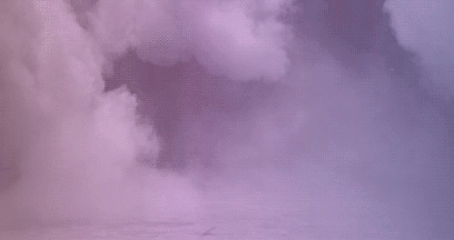
Deer’s Forest
Ruby Andreatta

Slide 2
Project overview - 1 page
Deer's Forest: a game about a mysterious statue, frozen in time and willing to give clues to the player to find orbs of life in the shape of mushrooms that are able to free the statue, ultimately freeing the player from the forests clearing.

Slide 3
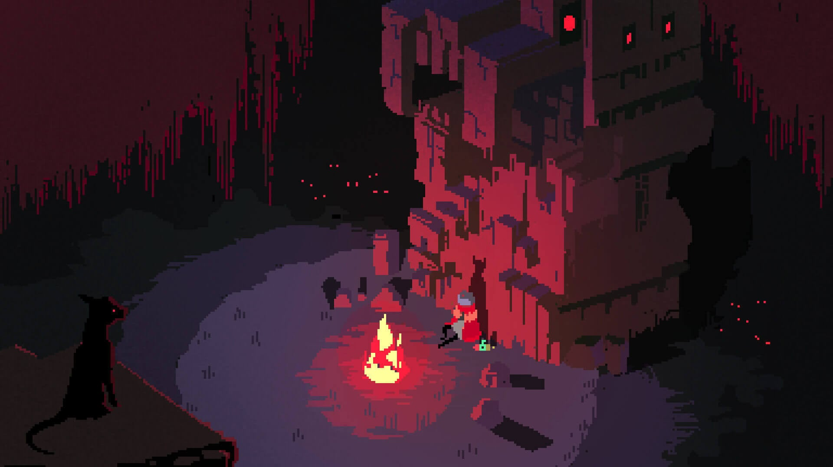
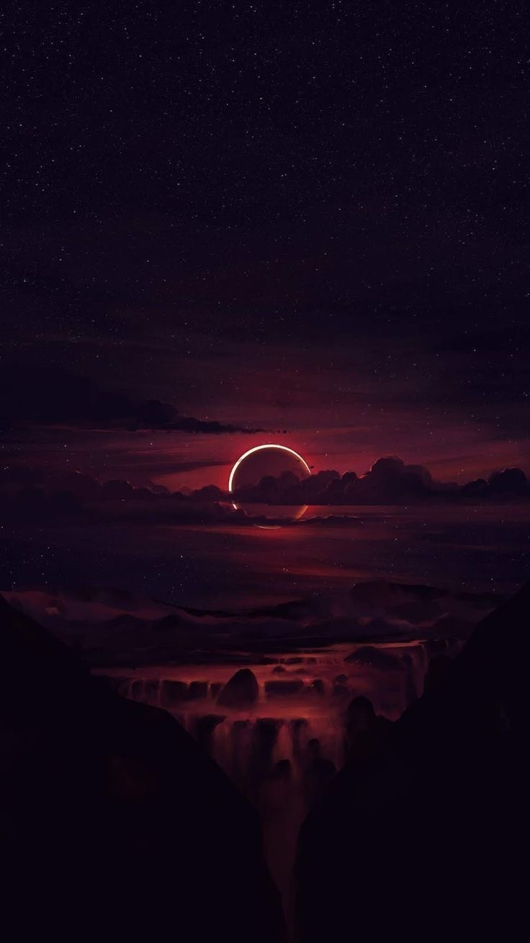
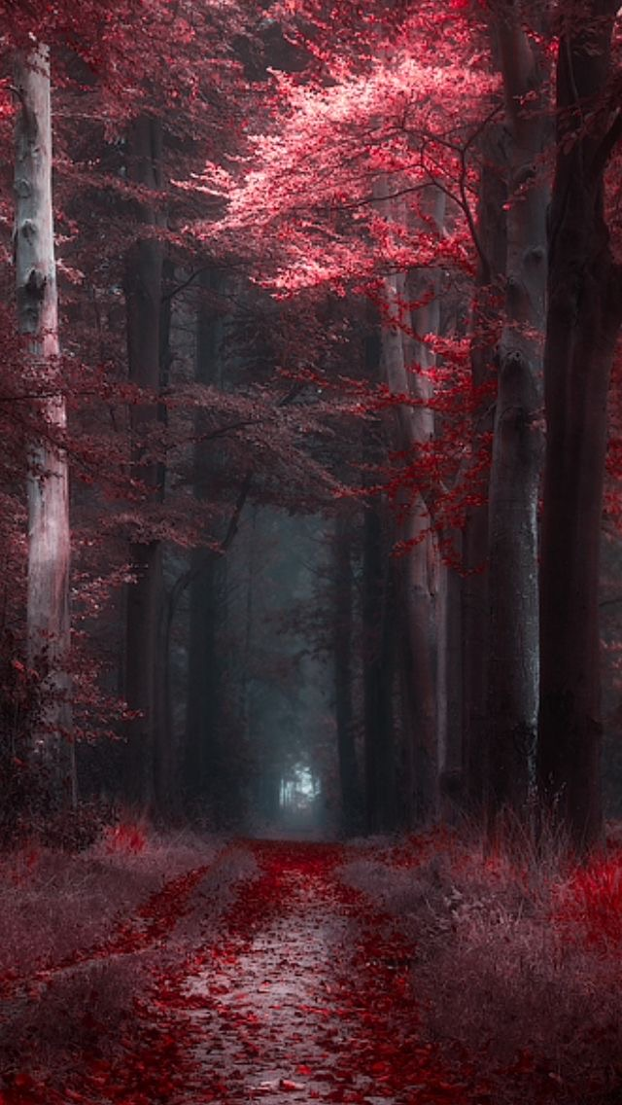
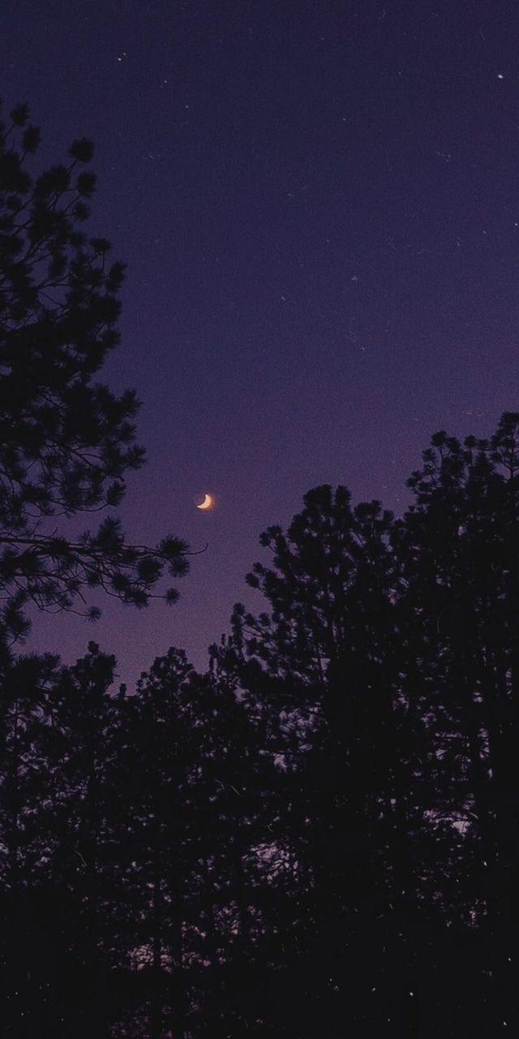
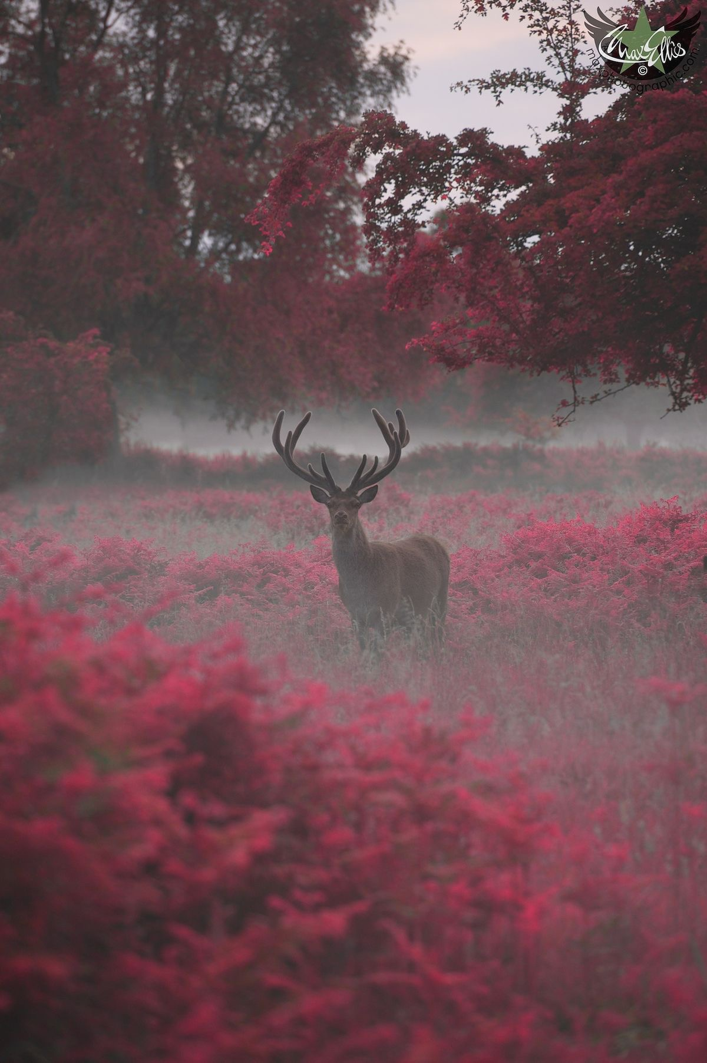
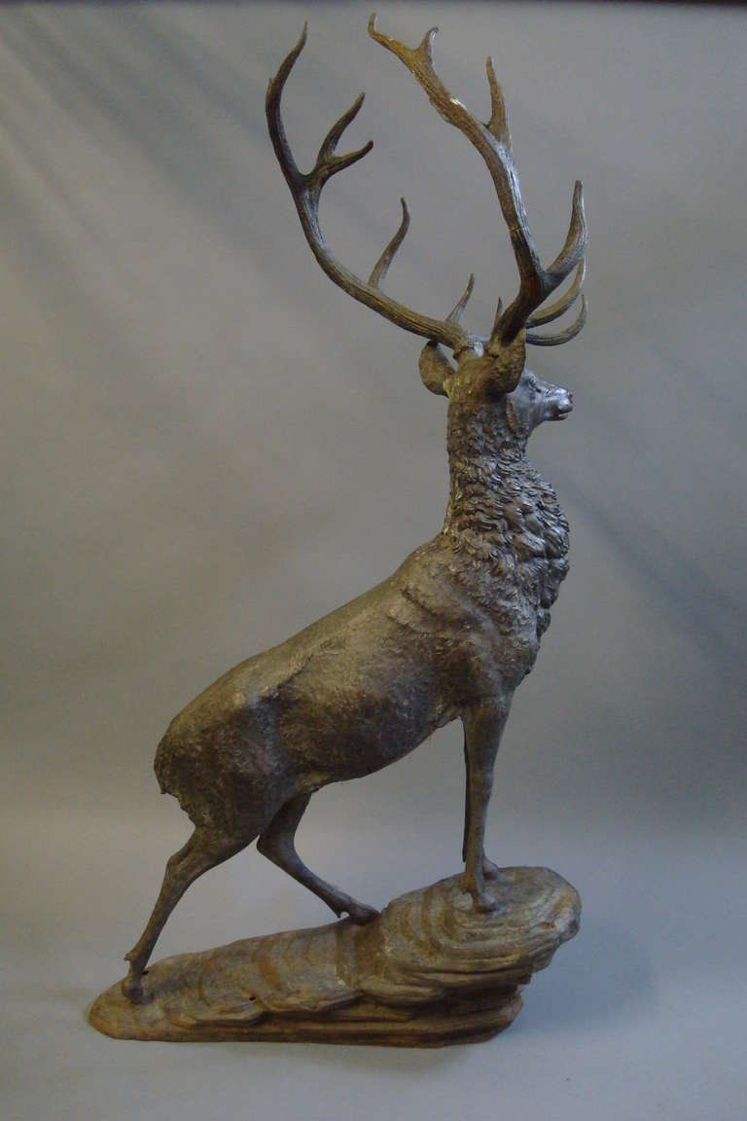
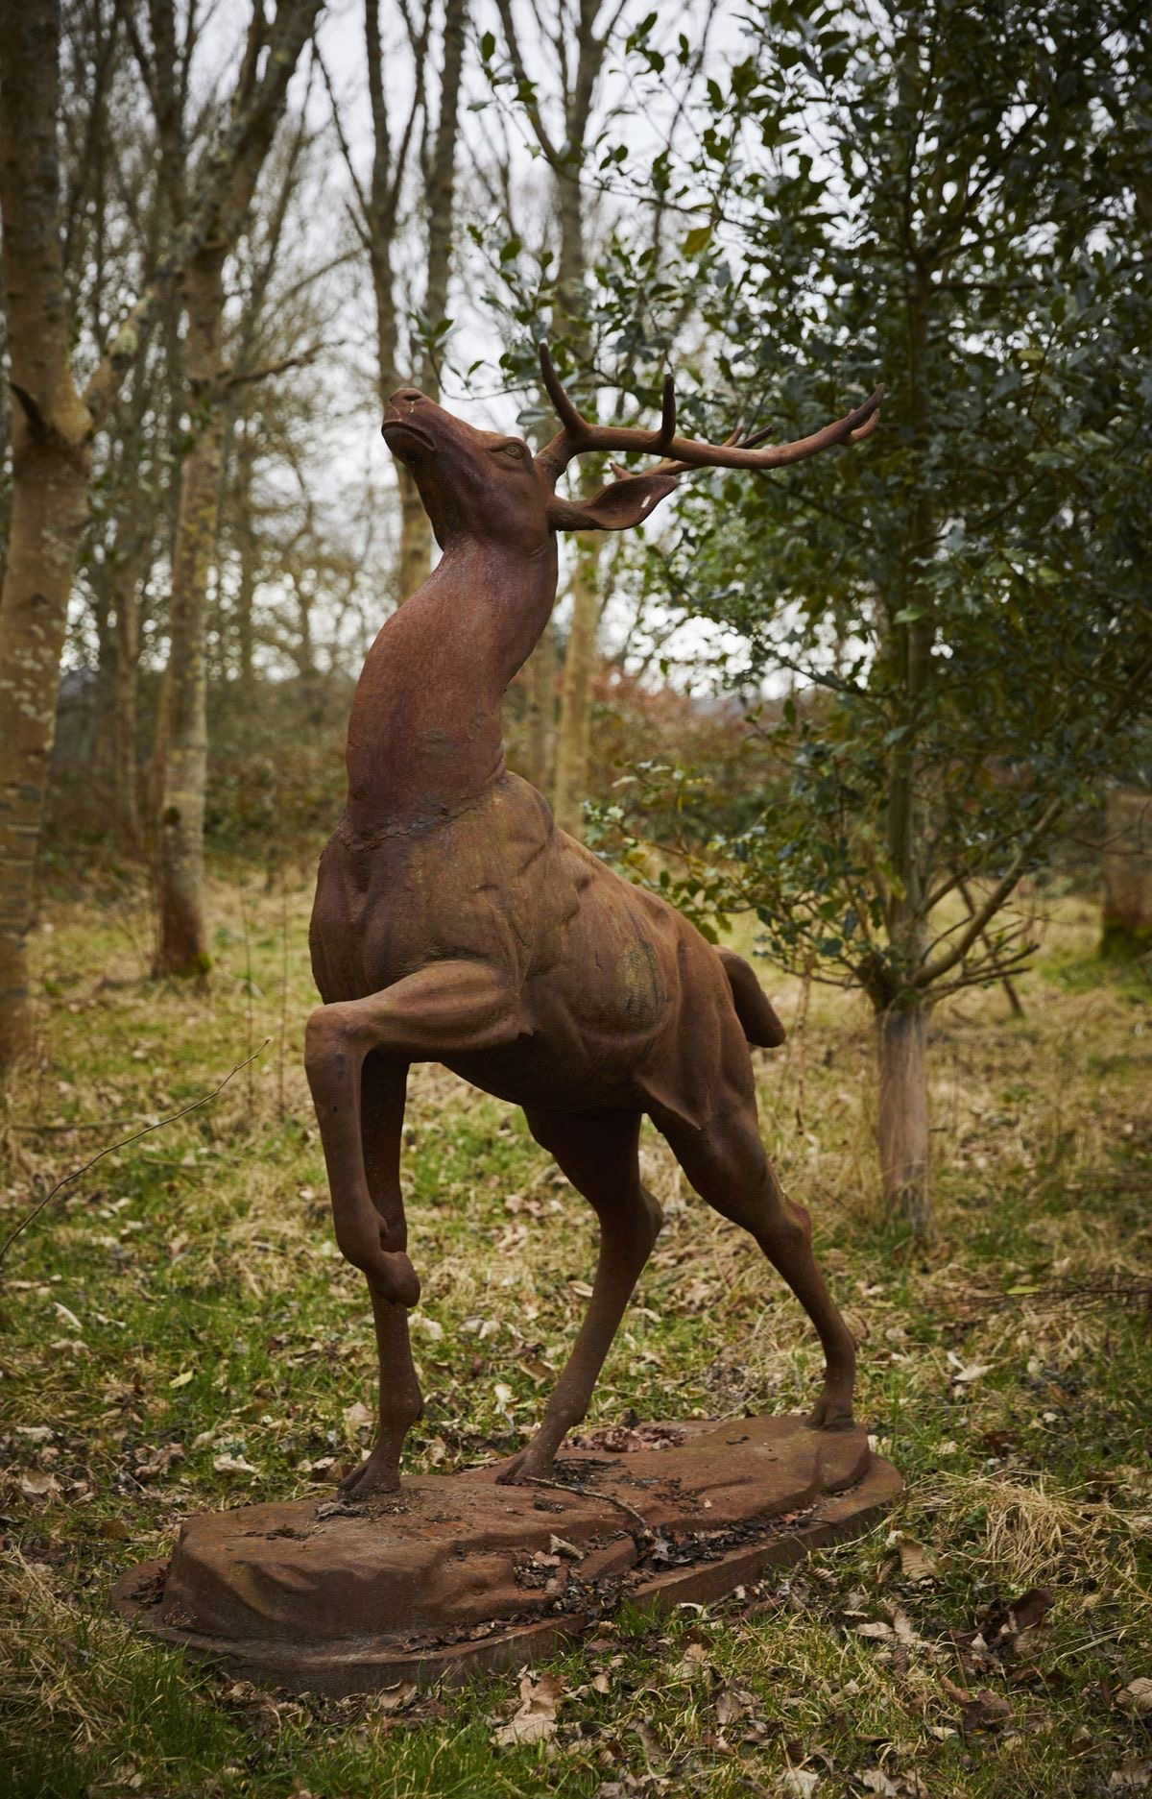
Reference/mood board – 1 page
White bark, blood red leaves and purple undertones (including mist or used as a tool to break up the colour palette)
Slightly creepy atmosphere that is also mysterious but otherwise a beautiful forest scene.
A deer which stands tall in the middle of a clearing, with large horns that reach high above.
The full moon is the primary light source with some supernatural lighting for areas which are too dark.
Stone deer with no natural colours or soft fur.

Slide 4
Art style – (by section) 1 page each
Visual guideline for art creation for each section listed below
Will provide art and possibly technical direction if appropriate
Sections on:
Project Art Style (broadly)
Environment / Atmosphere
Characters
Models
Textures (including line-work, materials, etc)
Camera
Lighting
Colour Palette (ref. Game / Char / Environment as approp.)
Level of Detail
UI Style
Each section requires reference imagery – No exceptions
Annotate images to ensure clear context

Slide 5
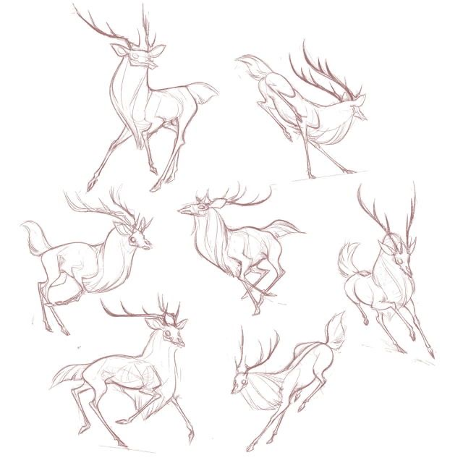
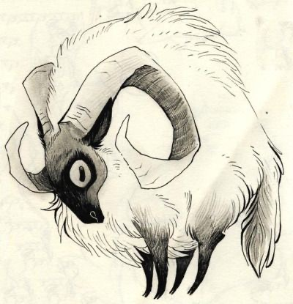
PROJECT ARTSTYLE
Stylized art style
Exaggerated features of the deer: slim and long legs, bulky chest with small hips, fluffy tail and large antlers.
Dark undertones with mood, eg: slightly creepier general vibe displayed in the art. This could include: glazed over or white eyes, sharp edges, thin skull.

Slide 6
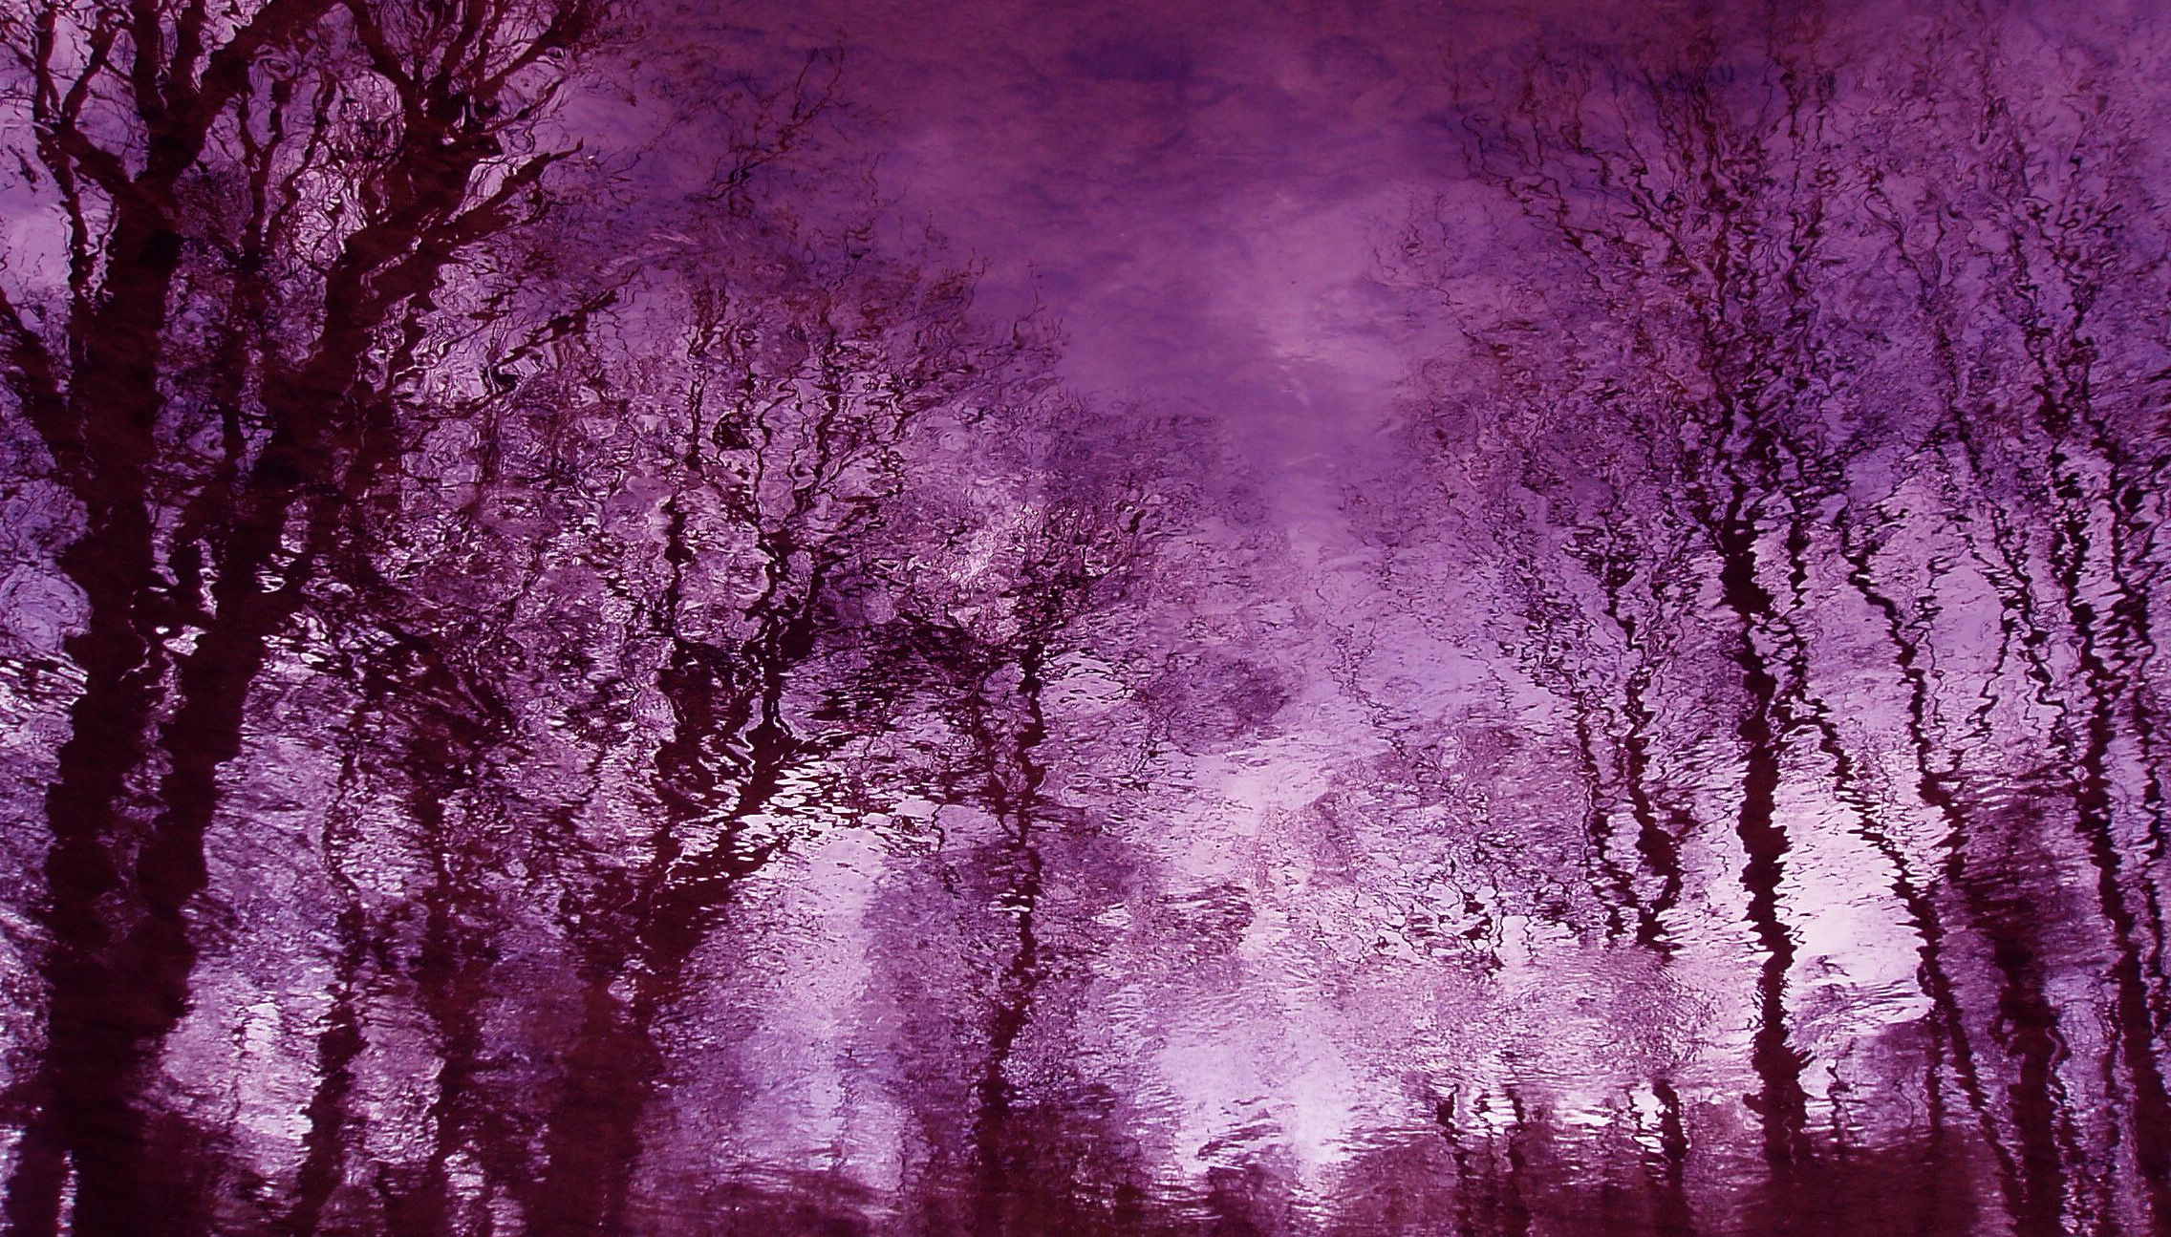
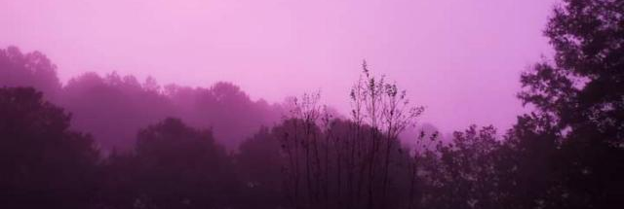
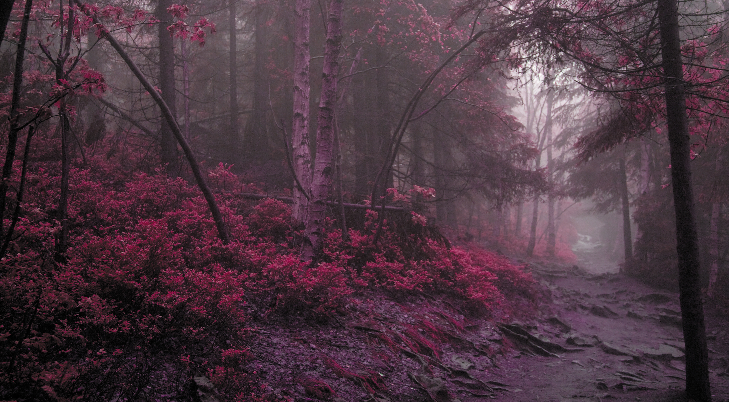
ENVIRONMENT/ATMOSPHERE
The fog is completely an eerie shade of purple.
A dark forest with red and purple hues
Red plant life
Light of the moon, the moon can be overhead or just rising.

Slide 7
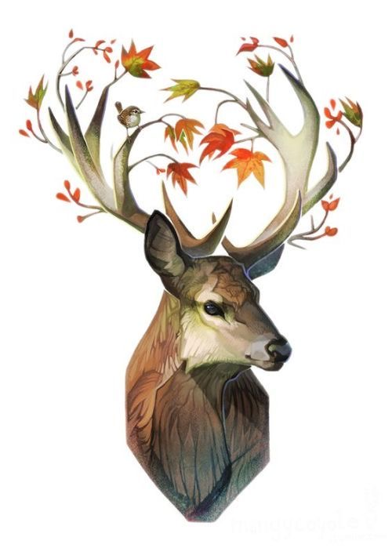
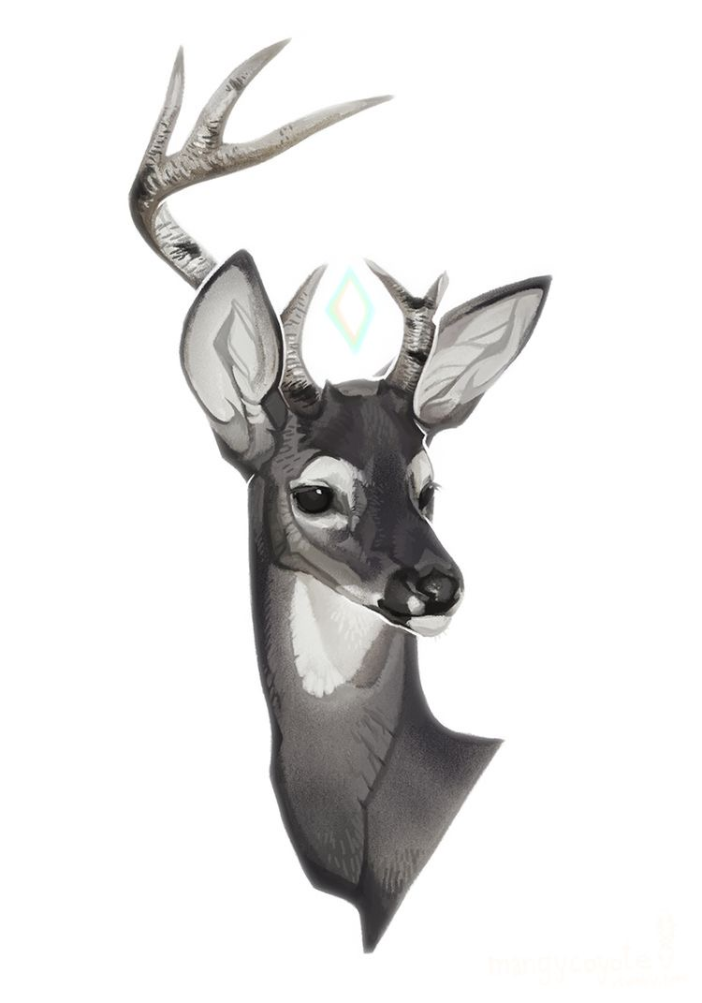
Model
Broken antlers (undesirable)
Plant life growing on antlers (desirable)
Statue that can speak to the player. (the only ‘real’ character in game)
The horns would be overgrown with plant life.
The head is slim with a defined skull.
Exaggerated features: slim and long legs, bulky chest with small hips, fluffy tail and large antlers.
Slim skull (desirable)
Triangular skull (undesirable)

Slide 8
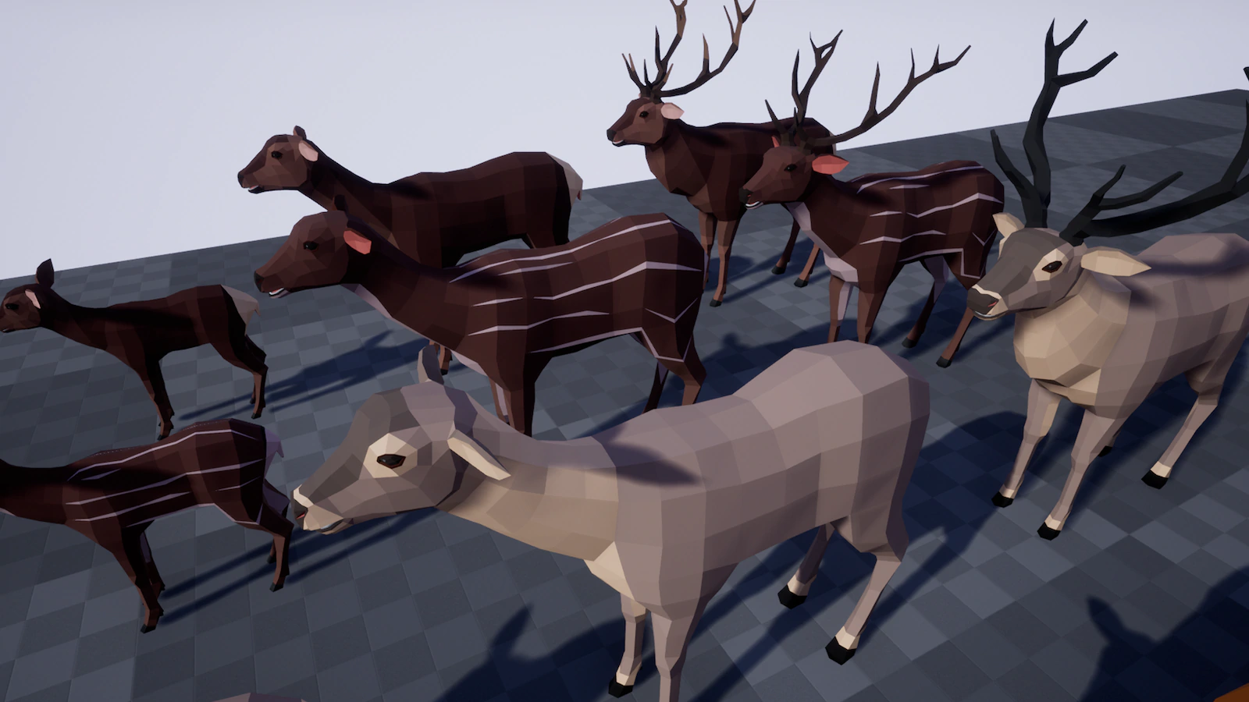
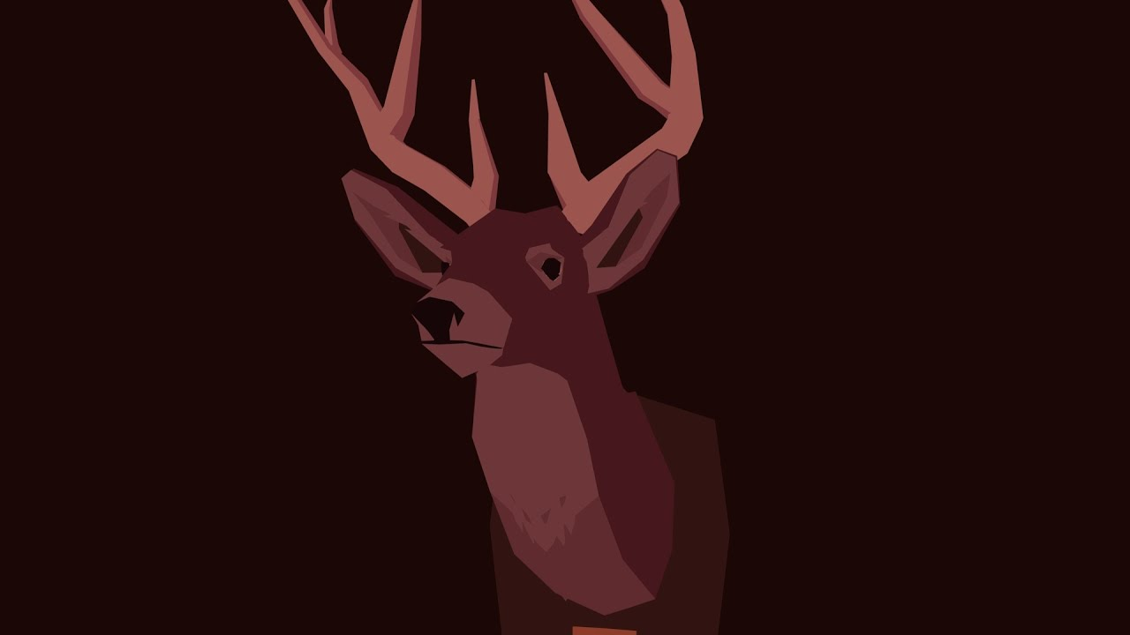
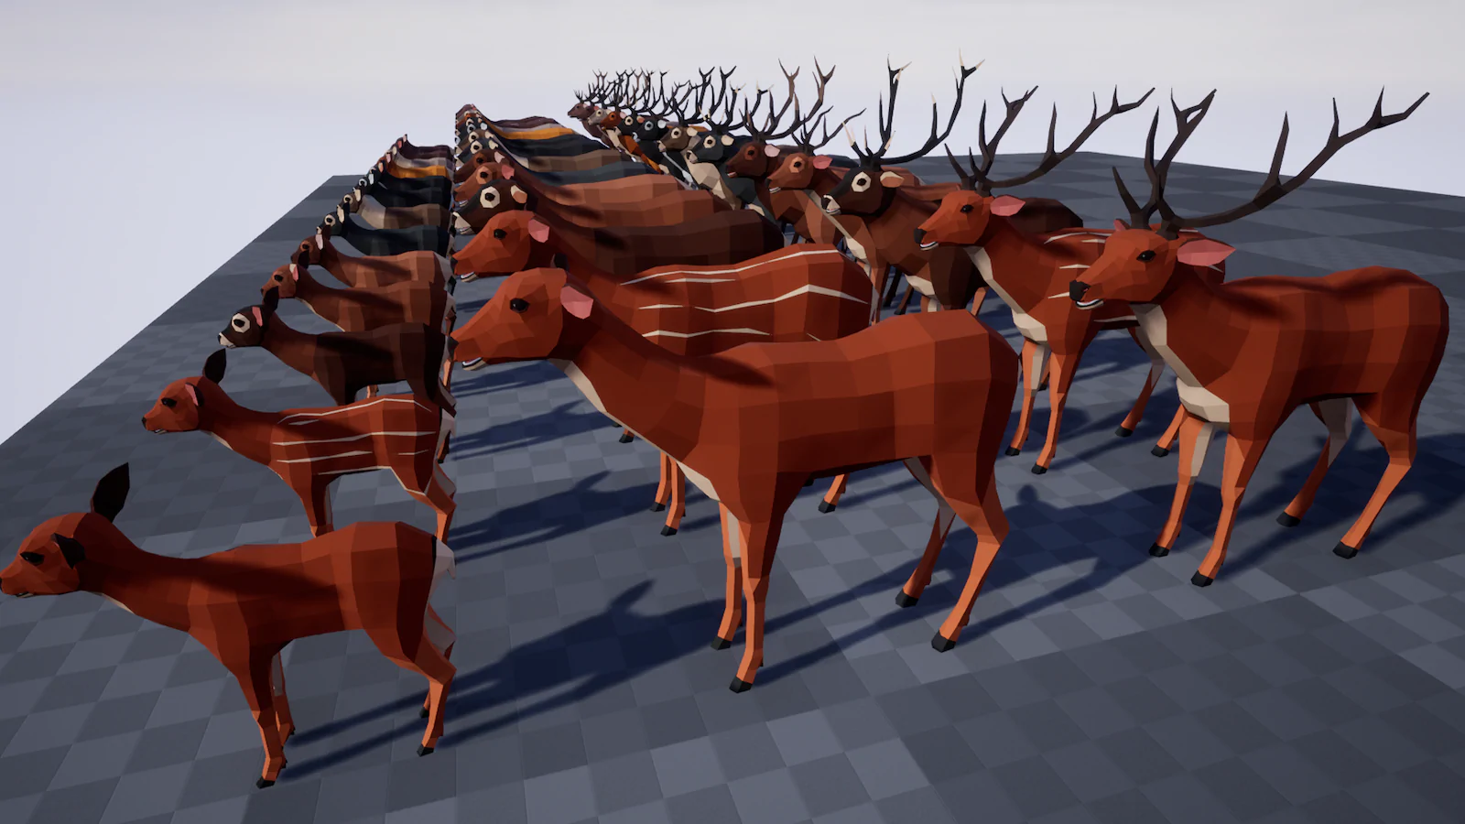
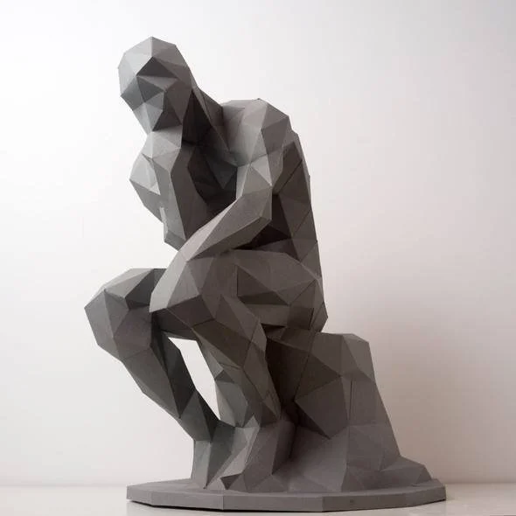
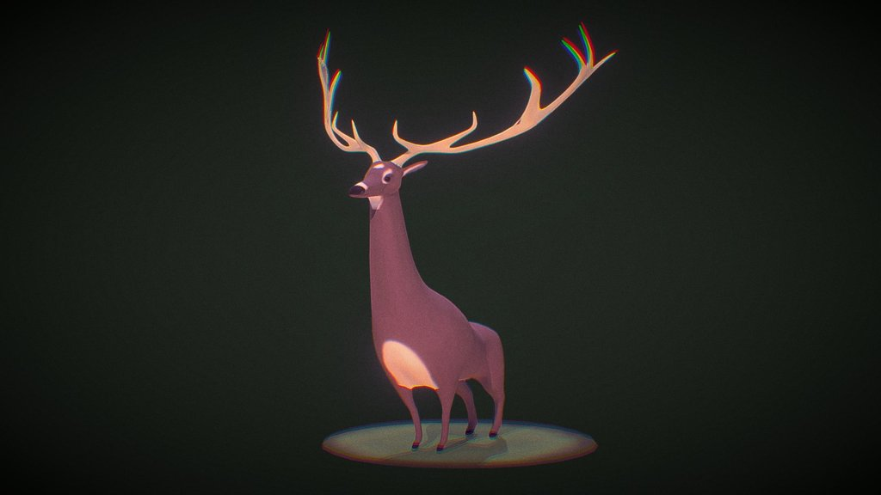
TEXTURES and level of detail
Texture:
Flat colours
Some diverse shades
Natural texture (no neon colours)
Level of detail:
Low poly count.
Not an extremely low poly count

Slide 9
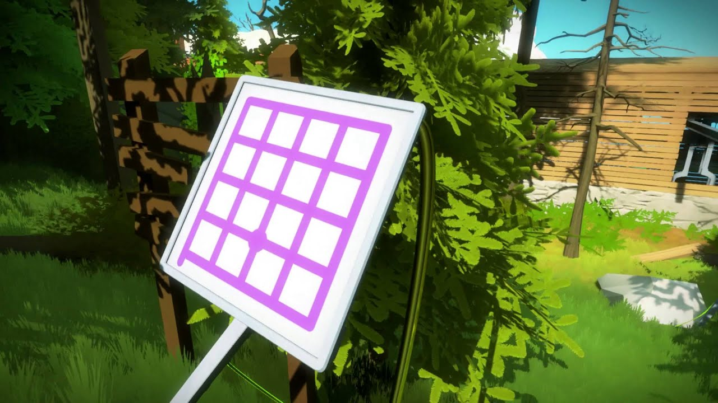
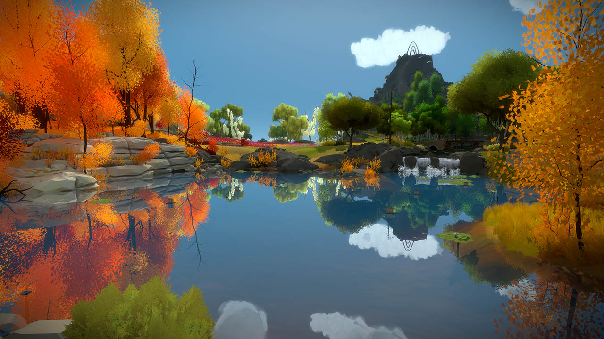
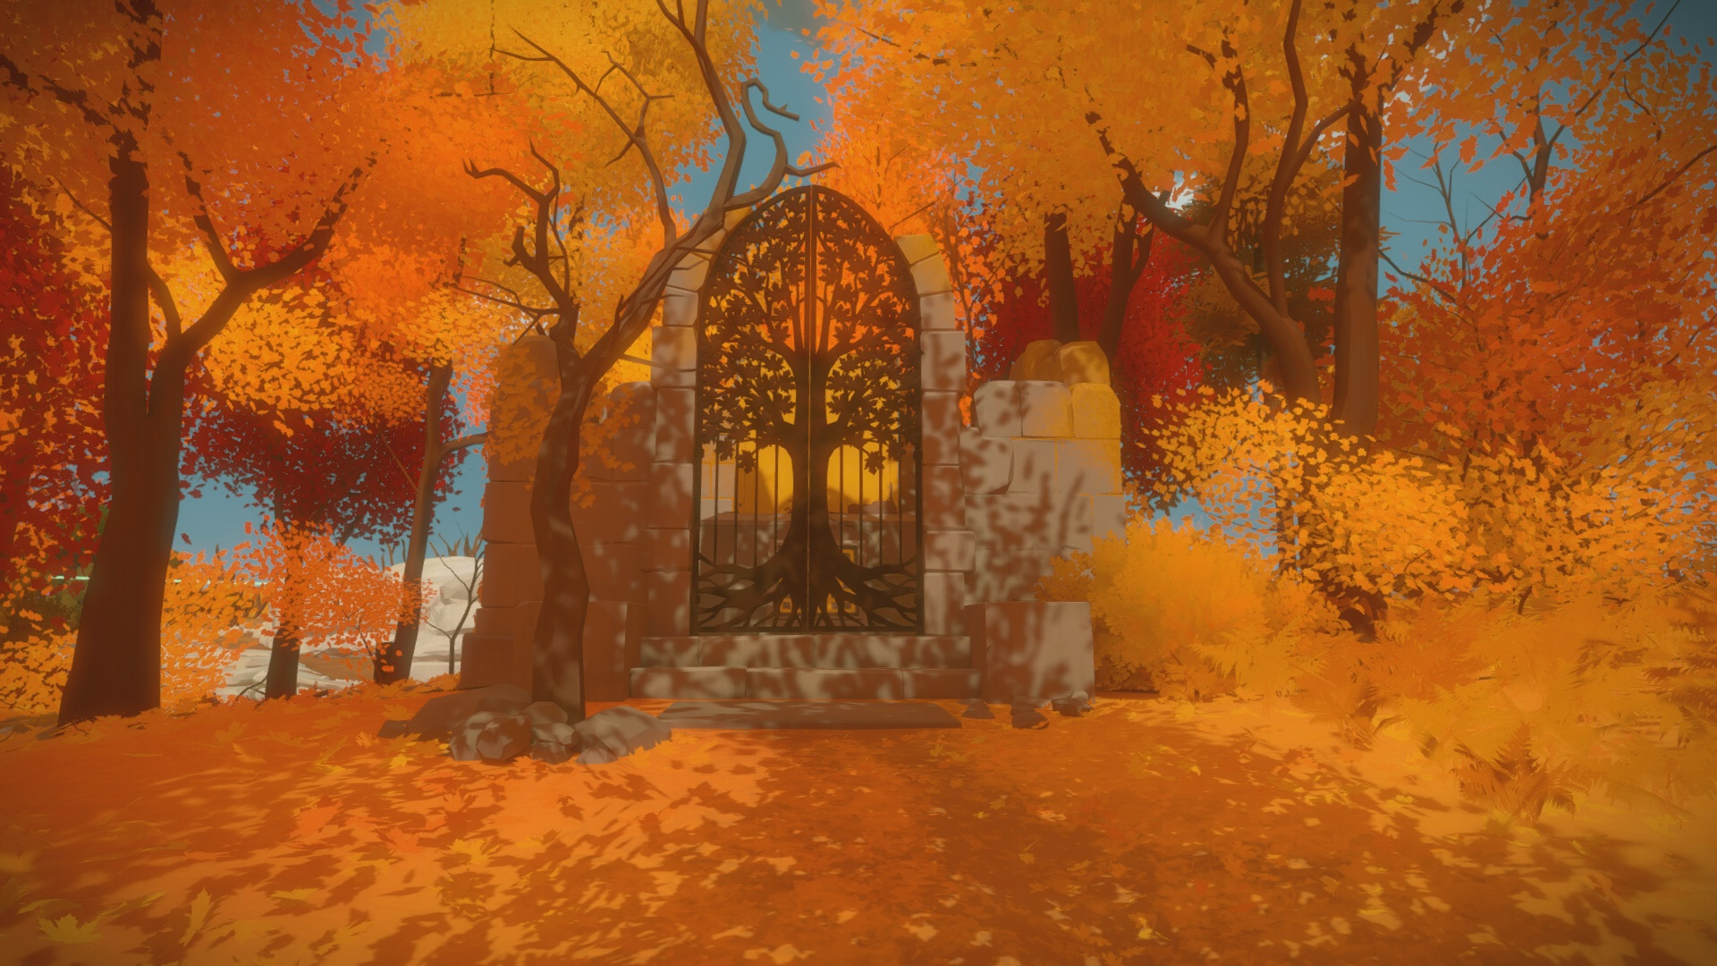
CAMERA
First person camera
Fixed perspective
Face is fixed to look forward, unable to glance sideways unless moving position.

Slide 10
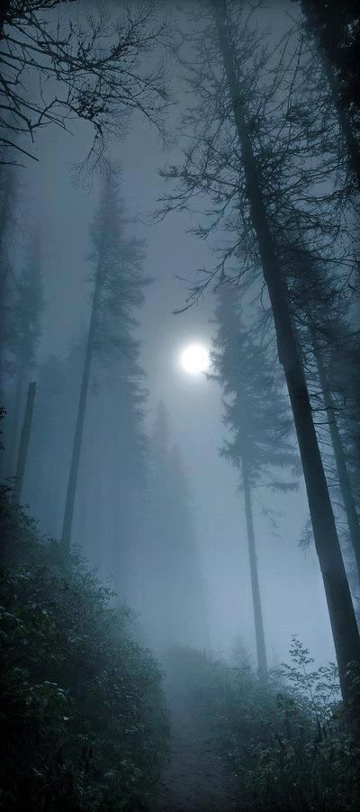
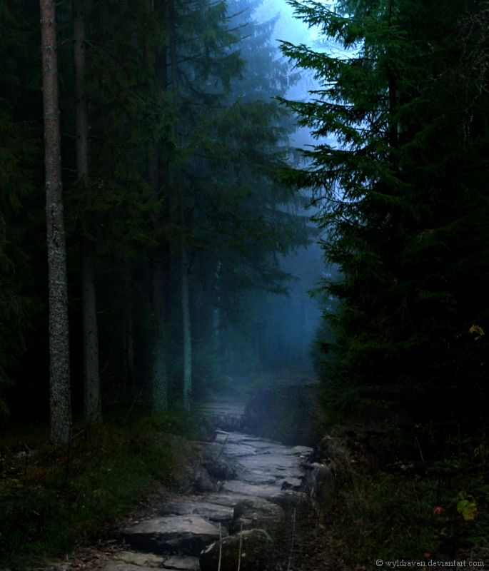
LIGHTING
Moonlight from the full moon. (either directly overhead or a rising moon)
Fog, some parts have low vision.
Cell shaded
Red environment, purple lighting/fog.

Slide 11
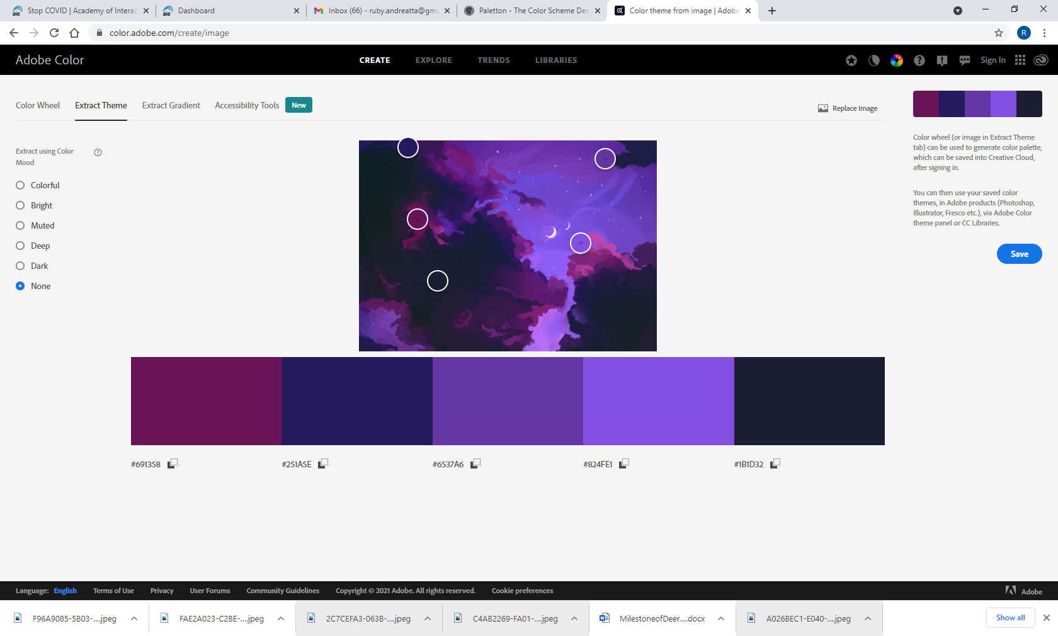
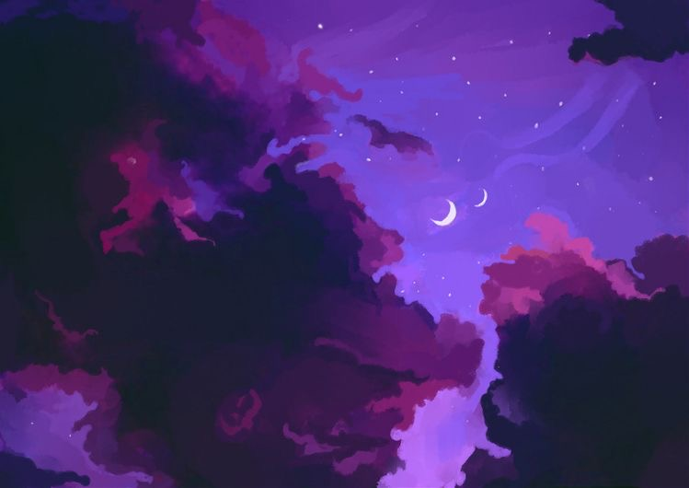
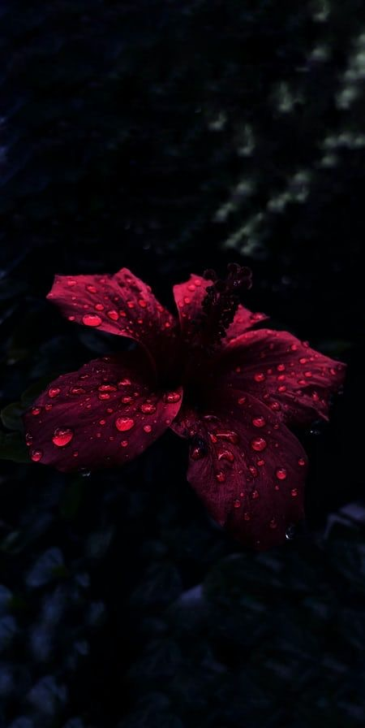
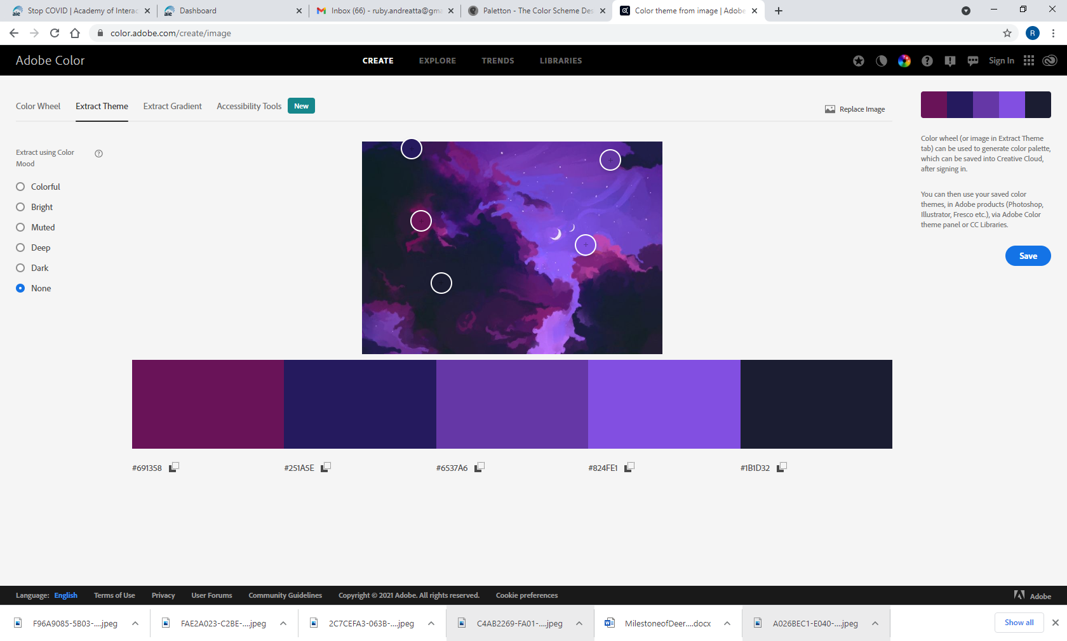
Colour palette
Almost completely shades of purple and red.
The contrasting colour of the environment would be a deep red that borderlines with purple so it is not too much of a harsh contrast.
Colour theory
Purple: mystery, alure
Red: danger, power

Slide 12
UI STYLE

Slide 13
Key Assets – Concept to Final Model – 2 pages (when done)
Must be of a ‘feature’ asset (not just a prop)
Must have 3+ reference images w/notes or annotations
Must have notes on purpose / use in game
Must show asset at all of these phases:
Concept
Grey box
1st pass
(plus any extra passes)
Final model (textured)

Slide 14
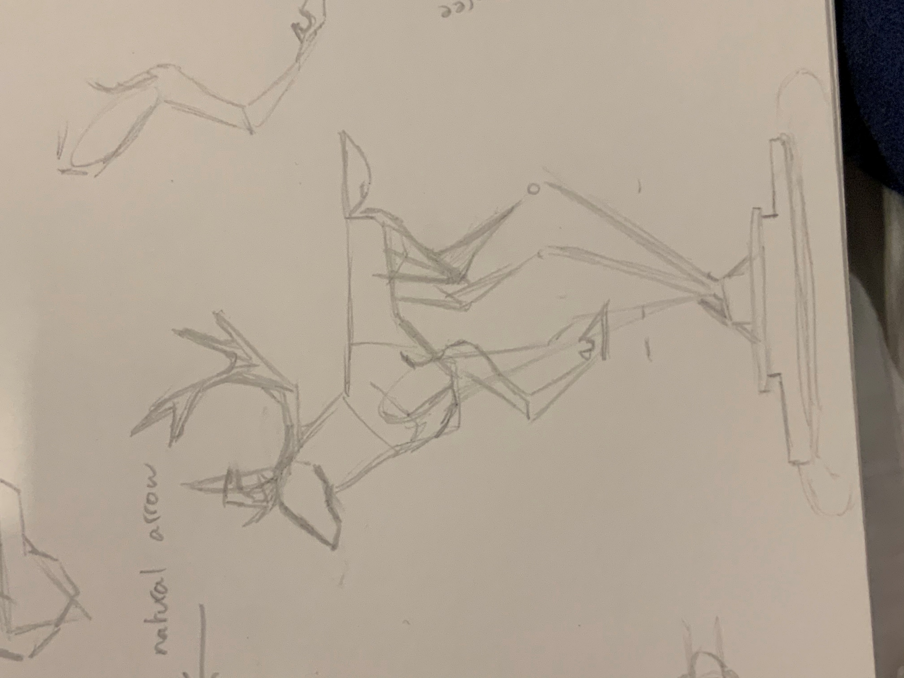
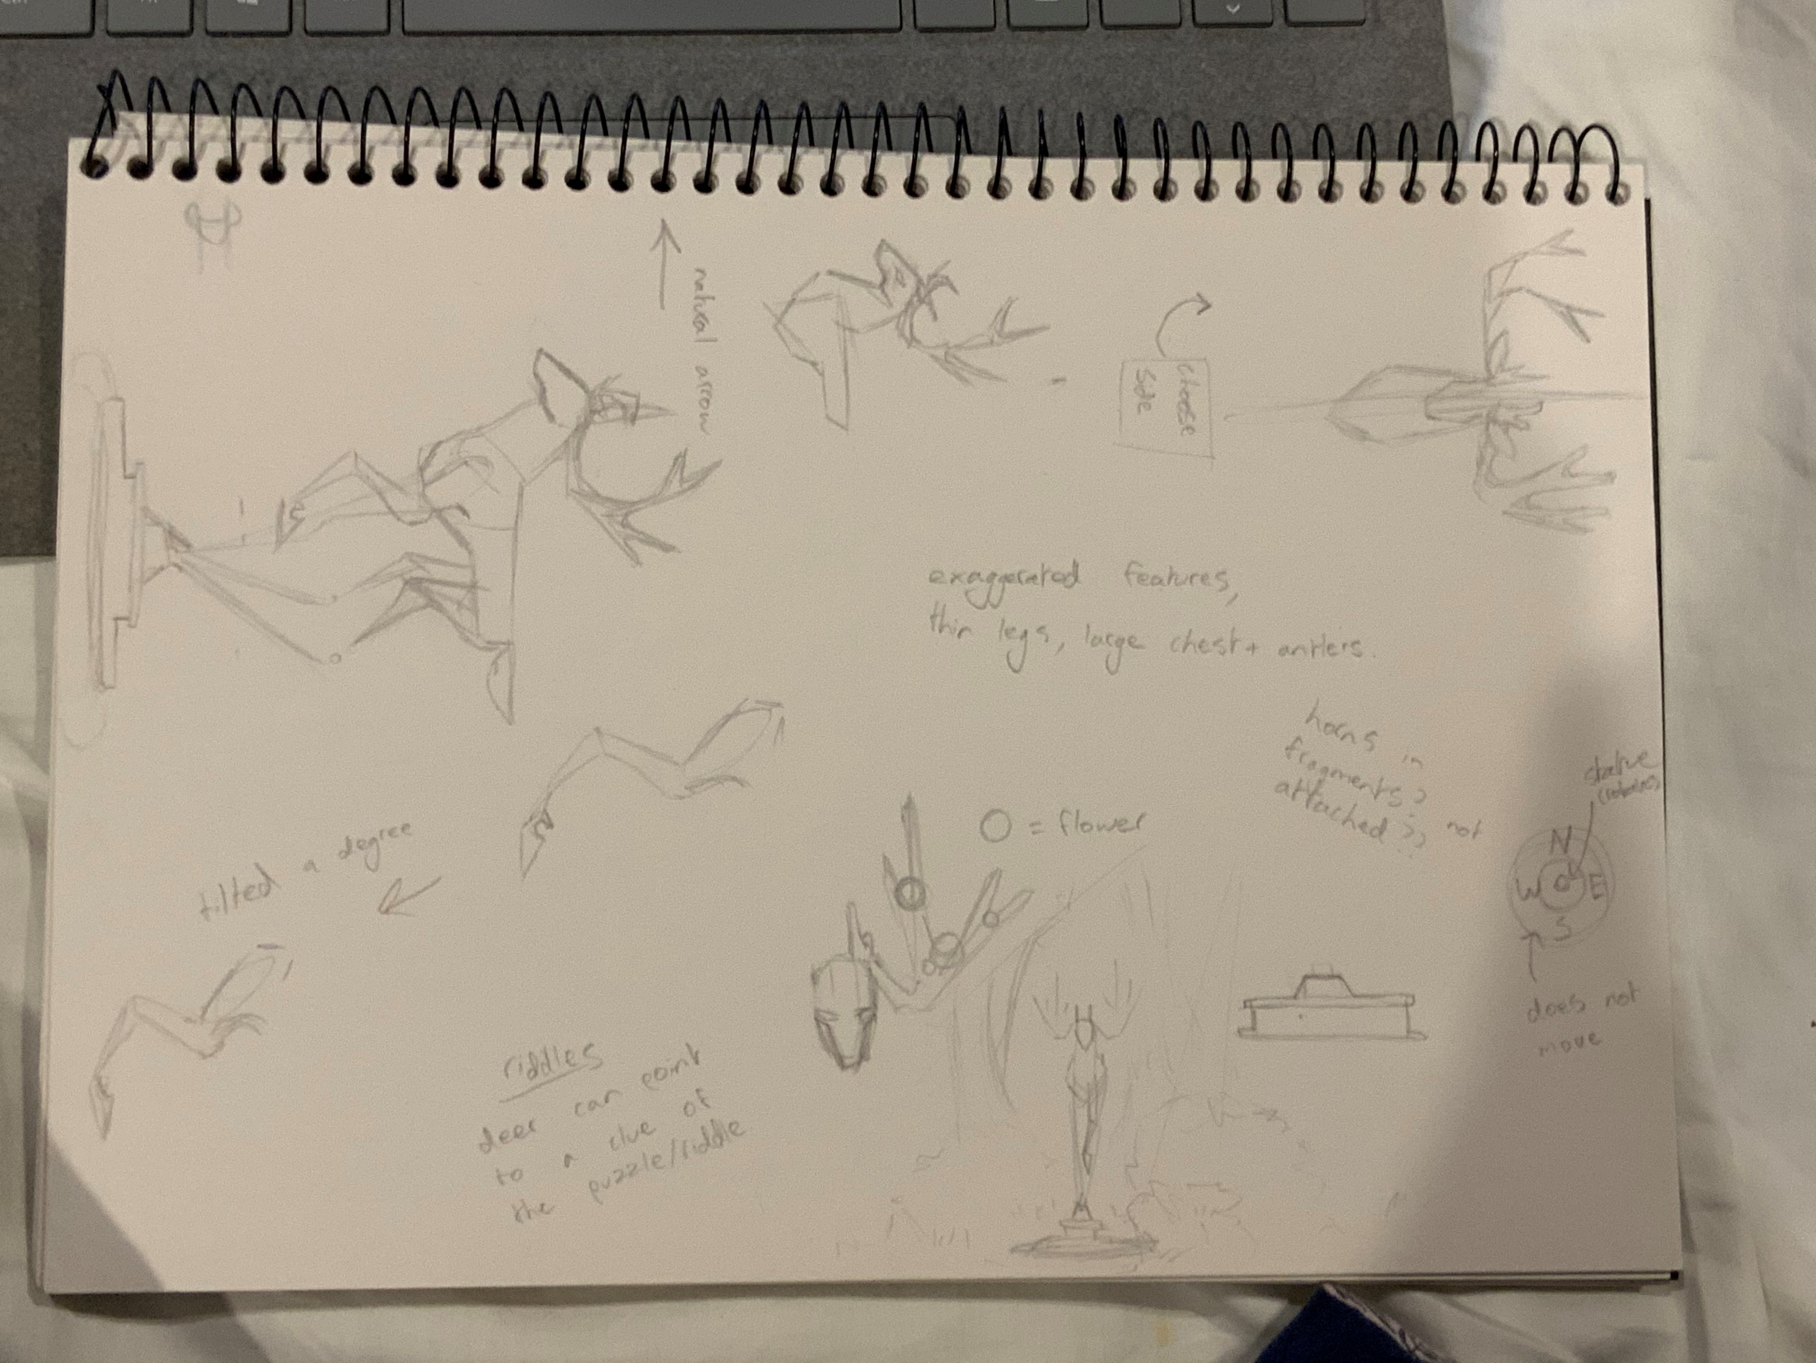
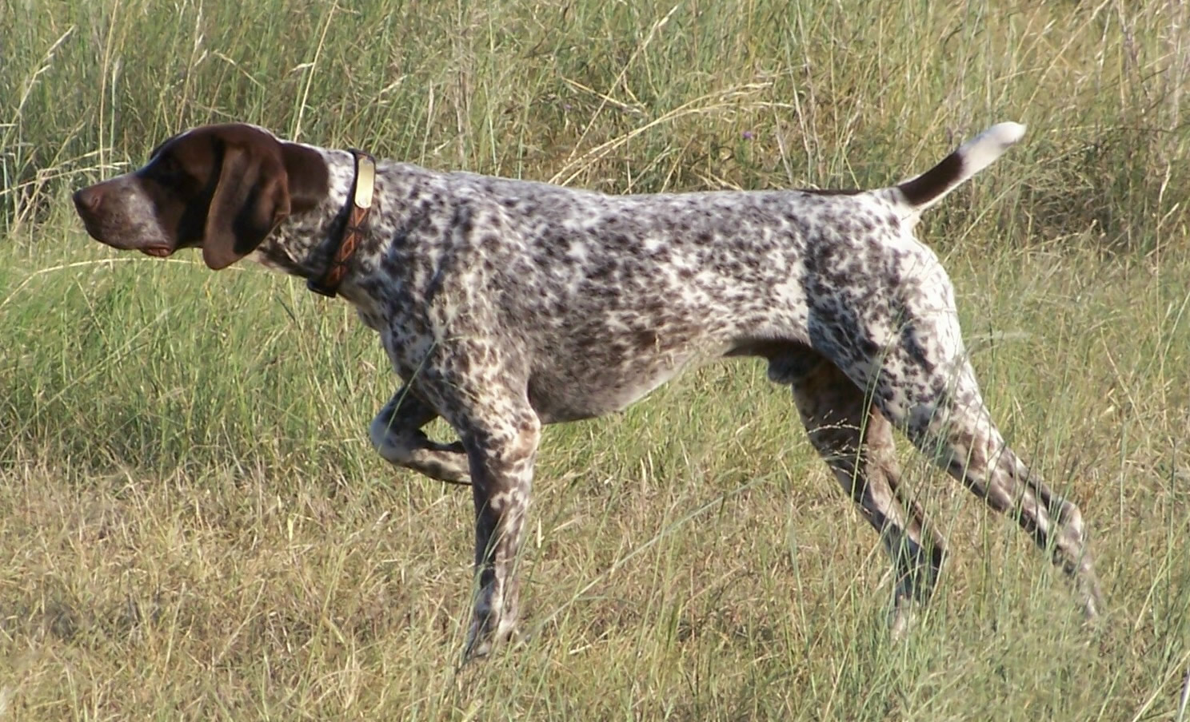
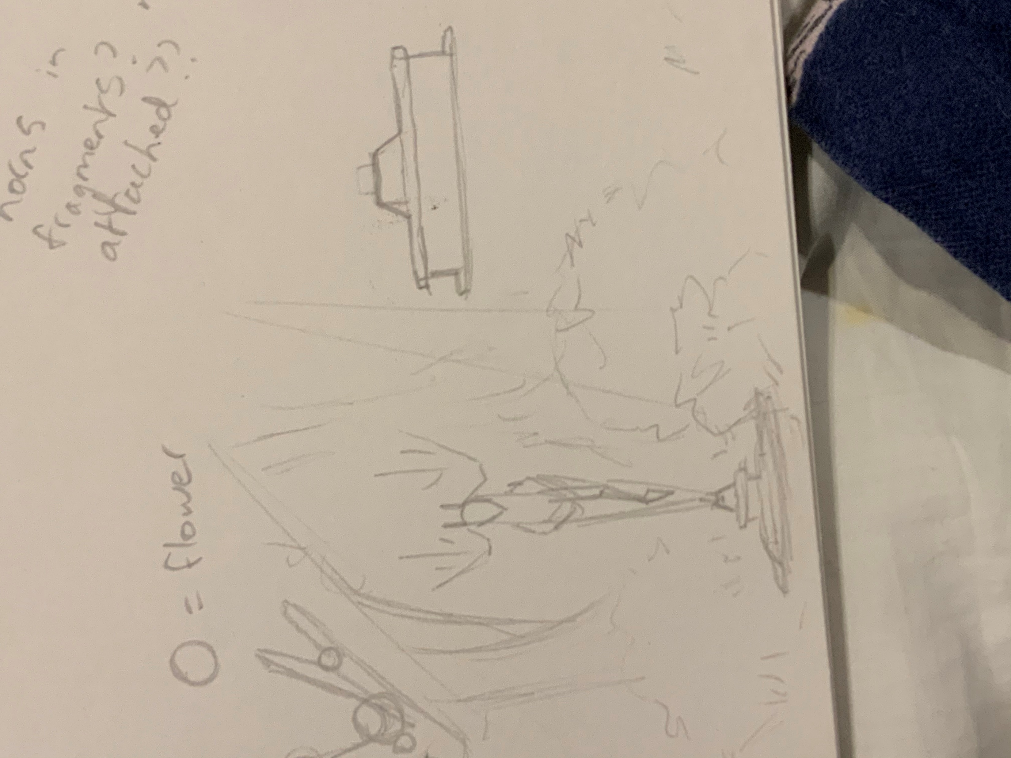
Concept
The feature asset was chosen to be a statue that can rotate, it had to be both a deer for aesthetics and a subconscious arrow for gameplay.
The deer has a bent leg to point a direction, with a straight tail and pointed nose. This mimics an English pointer dog that points.
This concept art shows the desired background setting and front view.
The concept also shows a redesign of the antlers where they float.
A completed base on their own is also visible, the pedestal.

Slide 15
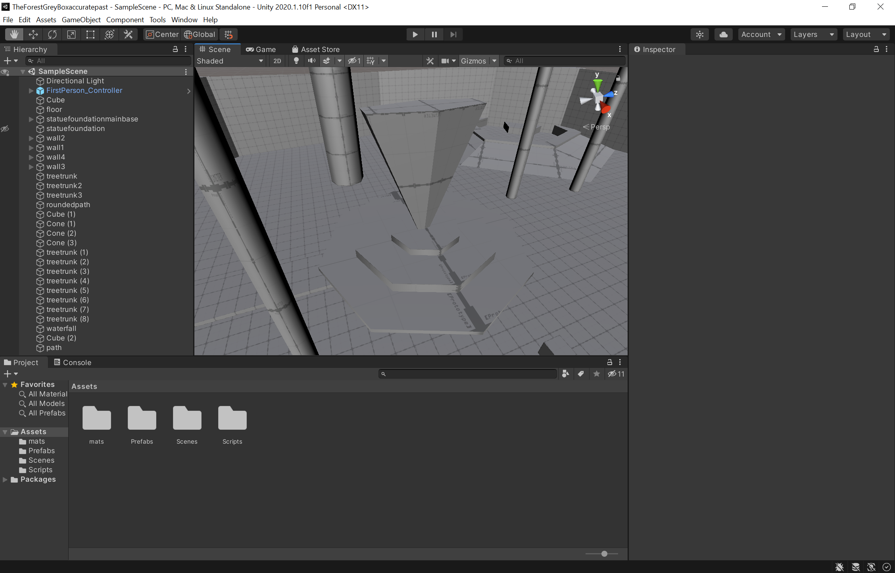
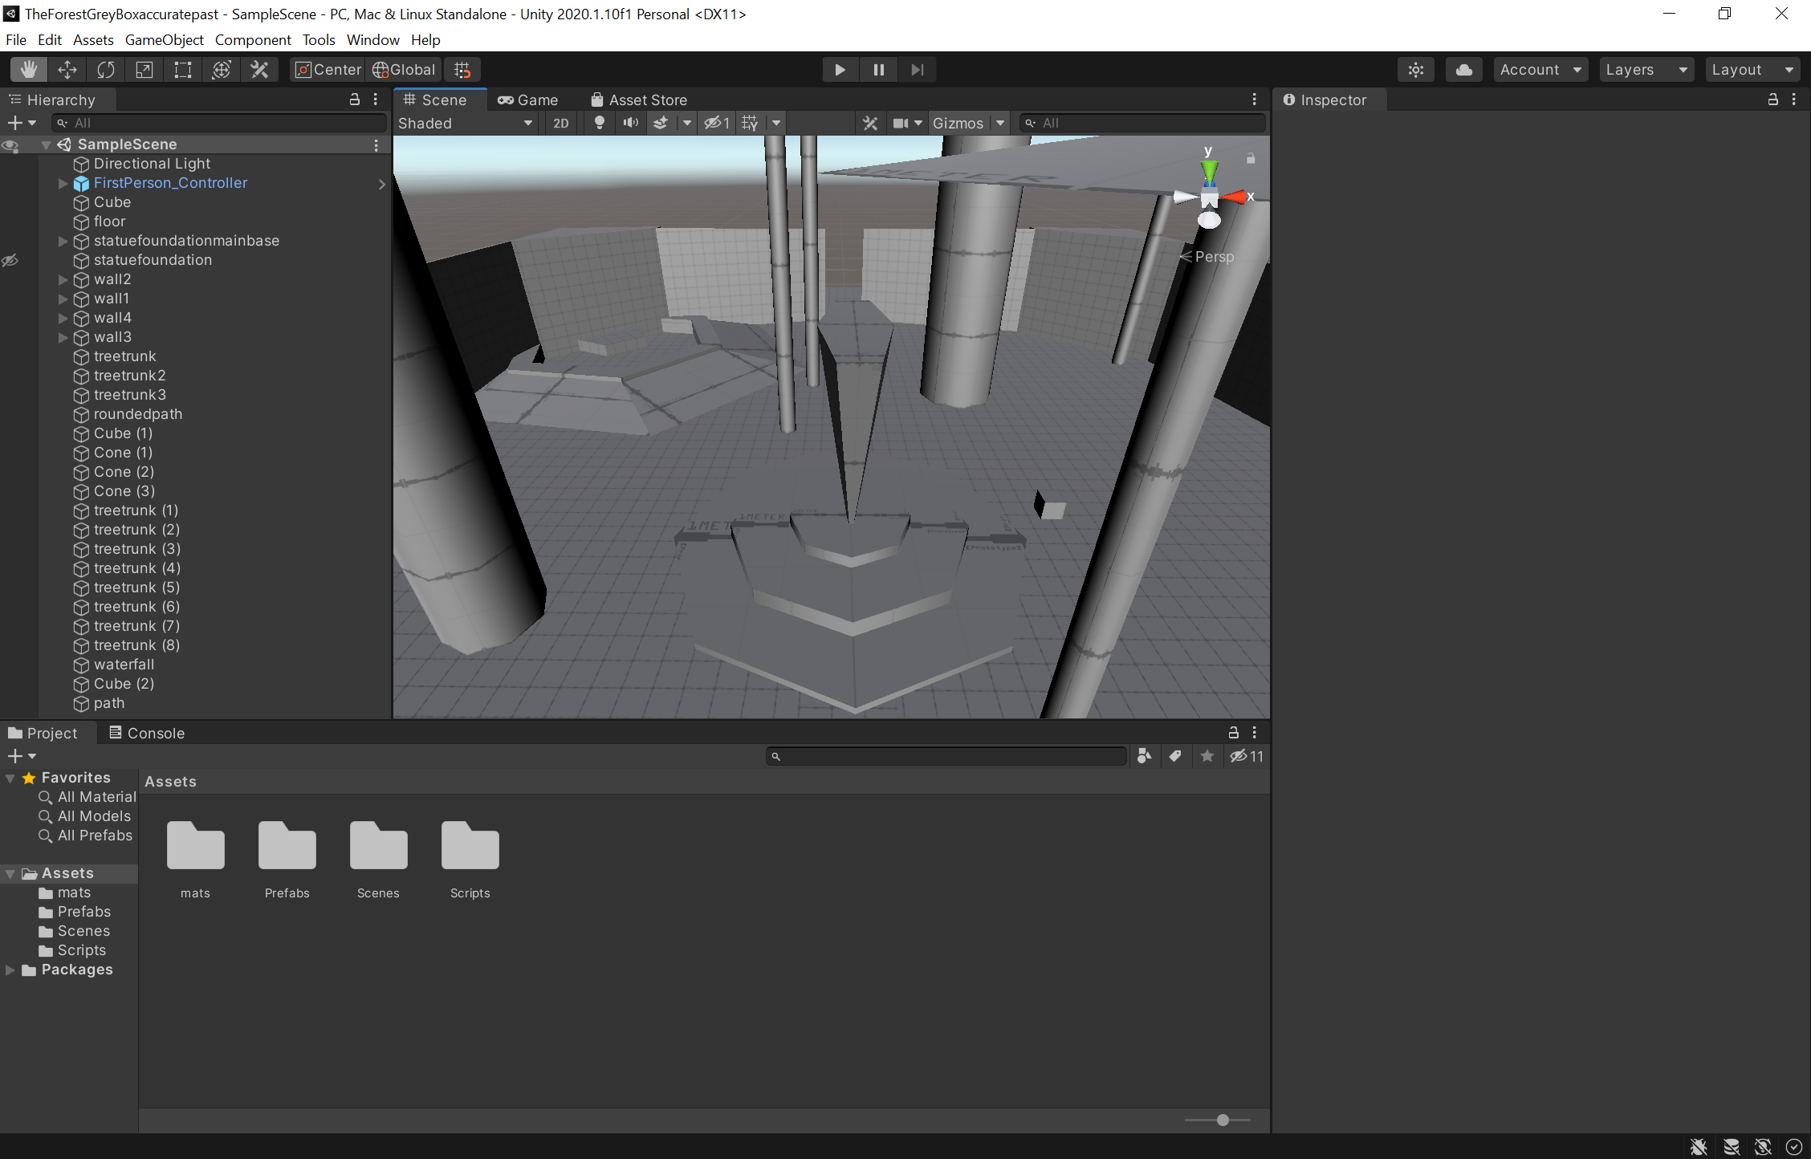
Grey box
Solely size reference rather than shape (though the shape is accurate to the overall upside down triangular shape.) of the statue.
Side angle is shown to be longer for the shape of a deer.
The front view is a replica of what the front is meant to mostly be (the concept art of the front view) including some trees behind them.

Slide 16
1st pass

Slide 17
Final model (textured)

Slide 18
Design Rules – 1 page
Mushroom orbs (what must be collected) are hidden until the riddle is solved.
No player model, must be first person that can move in any direction meaning all models must look decent from every angle.
No animation, feature asset must be a statue.
No large details such as fur meaning the deer was always going to be a statue that was solid with no fur.

Slide 19
Art tools – 1 page
Maya: a 3D art program that models, UV unwraps and textures models that are created.
Adobe illustrator: an artistic software that is for 2D art but can be transferred as textures onto Maya models.
Unity: a game development software that can put everything together.
Pipeline diagram

Slide 20
Technical Guidelines – 1 page
Identify platform
Nominate file types and formats (exporting)
Nominate naming conventions to adhere to
List folder structure
Any relevant limitations

Slide 21
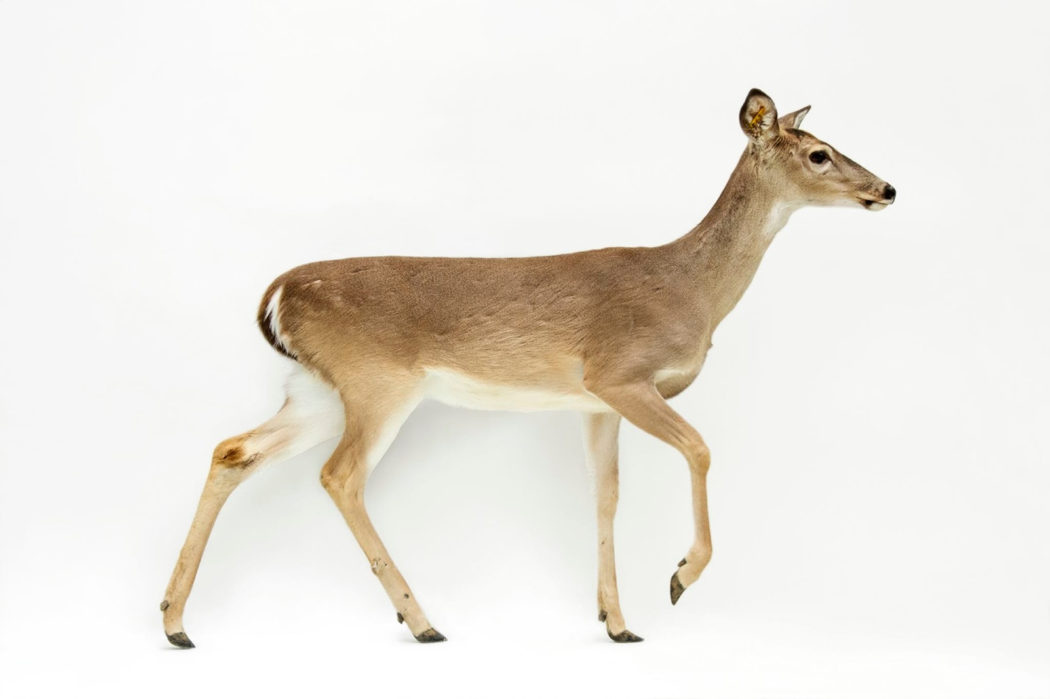
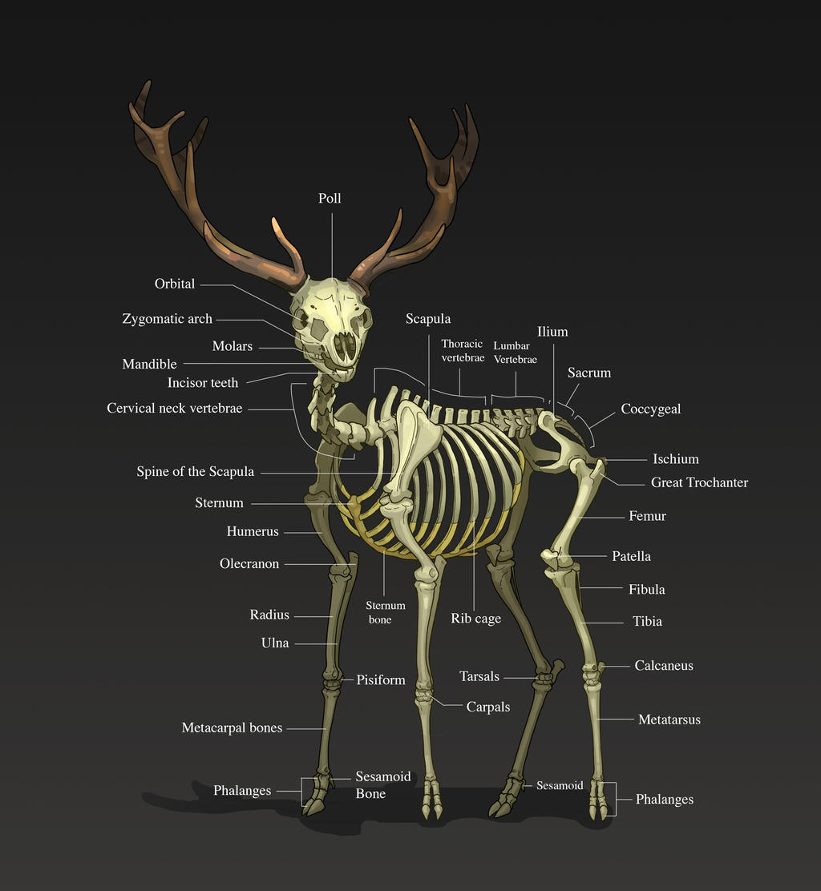
References

